Slide 1
Lesson 3: ‘Lists & Strings’
Chris Wing

Slide 2
Recap from last time…
Last week we covered functions and importing.
We write functions to define a specific section of code that performs a specific purpose.
We also write a ‘main’ function to define where the start of the program is.
We can also import functions and modules from one module to another.
Exercise: How would we import function ‘sum()’ from the module ‘math_tools.py’ into the module ‘main.py’?

Slide 3
What we’ll be covering today:
Lists, what they are and why they are used; how we define a list and how we use them.
String manipulation; splitting, slicing, reversing and joining.
Some examples that cover both topics.

Slide 4
Lists
So what is a list?
A list is a type of container that can hold a number of other objects or different types, in a given order.
A list is a data structure found within Python that acts in an almost identical way to ‘Arrays’ found in almost all other programming languages.
As with ‘for’ loops, list’s utilize the counting paradigm where we start at 0 and count from there.
More on this later on…

Slide 5
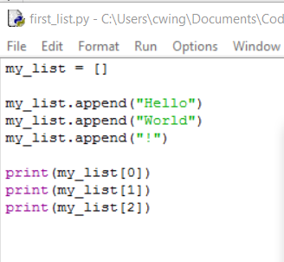
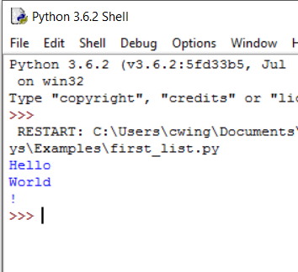
What does the code look like?

Slide 6
Lets break it down
We define a new list using the ‘[]’ characters, this defines it as empty. “my_list = []”
Next we are appending (or adding) new values to the list using the ‘.append()’ function. Anything inside append(‘’) will be added into the list as a new element. “my_list.append(10)”
Lastly we are printing the contents of the list. To access the values inside the list we use the square brackets ‘[]’ followed by the value index ‘[0]’.
The index of an item can be thought of as the position in the list it is located at.

Slide 7
Accessing lists differently
We just saw in the previous example that to access an item in a list we use L[i], where L is the list and ‘i’ is the index of the item (i.e. where in the list the item is located). However there are also a number of different operations we can perform to access list information:
N = len(L) → This will return the length of the list (the number of items held within the list)
Item = L[i] → This will return the item located at index ‘i’
Sequence = L[::2] → This will return a new list called ‘Sequence’ that gets every other item from list L, starting with the first. (Can also be done with other numbers, so ::3 would be every 3 items etc.)
Sequence = L[start : stop] → This will return a new list called ‘Sequence’, where Sequence contains all items in list L between the index’s ‘start’ and ‘stop’.

Slide 8
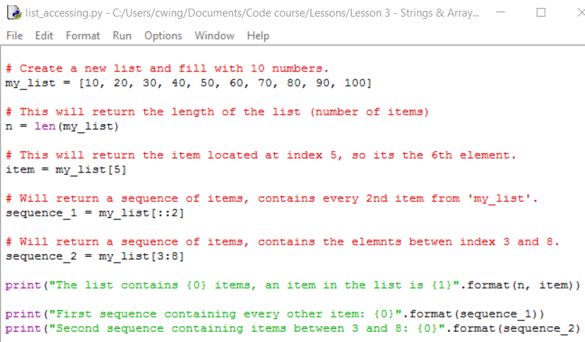
Lets see this in code
Lets compile and run this..

Slide 9
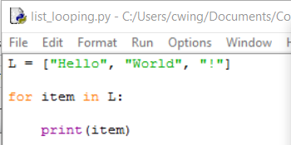
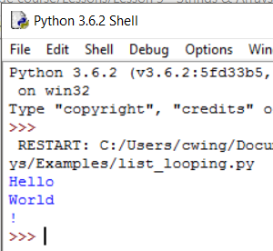
Looping over Lists
The for statement makes it really easy to loop over the items in a list:

Slide 10
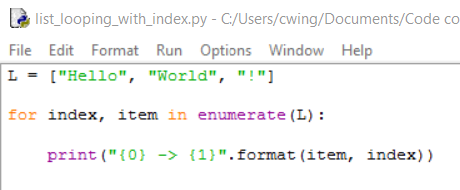
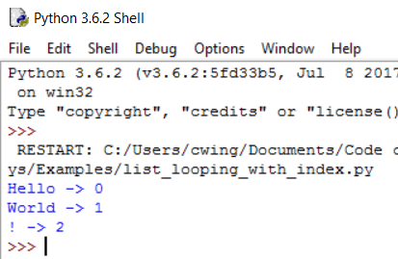
Another way..
We can also loop through the list using its index value as well:

Slide 11
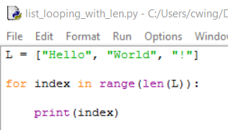
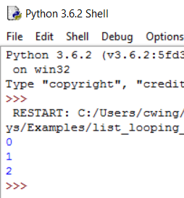
Using the index
If we only want to use the index value however, we don’t need to loop through the items as well:

Slide 12
List shortcuts
Python provides us with various pre-programmed shortcuts for us to manipulate a users list:
sum(L) → If the list contains only numbers, this will return the sum of all the numbers inside the list
‘,’.join(L) → If the list contains only string values, join() can be used to join all the words together using the character specified in the ‘’ quotes
max(L) → returns the item with the largest value
min(L) → Returns the item with the smallest value

Slide 13
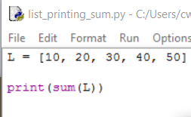
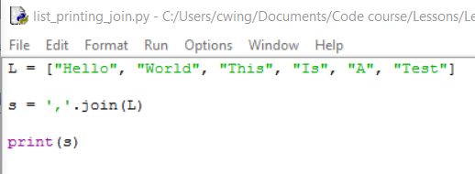
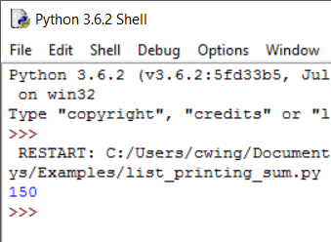
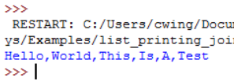
Lets see code for the first two:

Slide 14
List operations
Now lets cover some really basic List operations:
Del L[3] → This removes the item at index 3 from the list
[1,2,3]+[4,5,6] → [1,2,3,4,5,6] joins two lists together
[‘Hi’ * 4] → [‘HiHiHiHi’] will create duplicate copies of anything in the list (Try this with a number and see the difference)
3 in [1, 2, 3] → True; used to check if an item is in the list

Slide 15
List methods
Here are some basic operations you can perform on a list:
L.count(‘test’) → counts the occurrence of the word ‘test’ in the list L
L.index(‘hello’) → returns the lowest index value at which ‘hello’ occurs
L.reverse() → Reverses the order of the items in the list
L.insert(index, item) → inserts ‘item’ at position ‘index’ in the list

Slide 16
Strings
In Python there is no special character type; characters (i.e. individual letters) are treated as strings still.
Say we had the variable:
Word = “Hello”
We could access the letters of the word like so:
print(Word[3]) → this would print the letter ‘l’

Slide 17
String slicing
As well as getting an individual letter of a word, we can also slice the word at certain points:
Again we have: Word = “Hello, World!”
Now we could split the string with:
Split_word = Word[1:3] → “el”
In this example we are starting at index 1 and taking all the letters that are lower than index 3, so in this case ‘el’.

Slide 18
String formatting
Before to format strings with variables we used:
print(“Sum: {0}”.format(100))
Which would print: “Sum: 100”
We could instead do this in a simpler way:
print(“Sum: %d” % (100))

Slide 19
% character symbols
%c | character
%s | string conversion via str() prior to formatting
%i | signed decimal integer
%d | signed decimal integer
%u | unsigned decimal integer
%o | octal integer
%x | hexadecimal integer (lowercase letters)
%X | hexadecimal integer (UPPERcase letters)
%e | exponential notation (with lowercase 'e')
%E | exponential notation (with UPPERcase 'E')
%f | floating point real number
%g | the shorter of %f and %e
%G | the shorter of %f and %E

Slide 20
String splitting
In Python we may often come into situations where we want to split the string into a list, where every word in the string appears as an item in the list.
Do achieve this, we can split the string up:
String = “Apples, Oranges, Pears, Grapes, Tomatoes”
Now we can create a list and assign it the contents of the string:
L = String.split(“,”)
Now when looking at the list, it appears like so:
L = [‘Apples’, ’Oranges’, ’Pears’, ’Grapes’, ’Tomatoes’]

